Slide 1

Fastener Layout Optimization
Comparing Learning-Based (PINN) and Geometric (MMC) Frameworks
Supervisor Meeting — November 2025

Slide 2
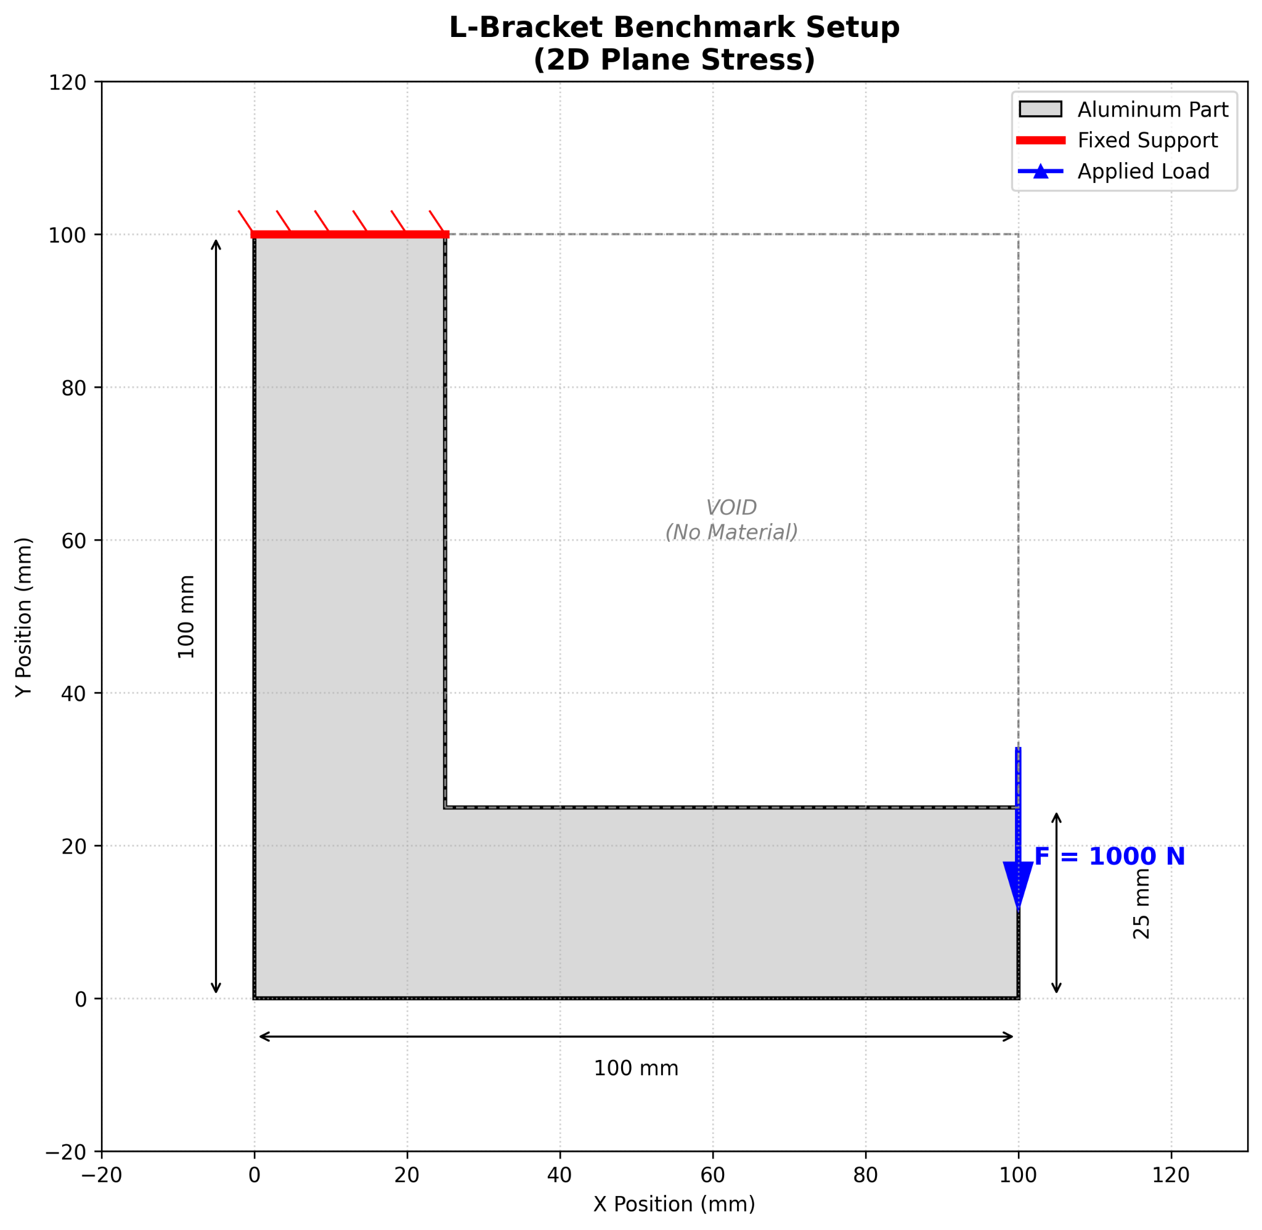
Problem & Dual-Approach Summary
Research Question
"How do learning-based (PINN) and geometric (MMC) optimization frameworks compare for discrete fastener placement?"
Two Approaches
•
Approach A: Hybrid PINN
○
Gradient-based optimization → Neural surrogate
○
Amortized: Fast inference after one-time training
•
Approach B: MMC (Geometric)
○
Explicit geometric optimization
○
Direct: No training, but slower per iteration
Benchmark Geometries: L-bracket, Tapered plate, Ribbed channel.

Slide 3

Multi-Geometry PINN Performance
Dataset & Training
Accuracy vs. Ground Truth
Total Samples: 1020 (Across 3 geometries)
Geometry / Load | MAE (J) | MAPE (%)
L-bracket / Horizontal | 3.28 | 0.95%
L-bracket / Vertical | 12.4 | 1.07%
Tapered plate / Tip | 1.55 | 6.75%
Ribbed channel / Up | 1.46 | 4.54%
Ribbed channel / Shear | 2.48 | 335%*
Architecture: 2×96 Tanh MLP (14 inputs)
Training: 1500 epochs, ~2 hours
Speed Performance
≥ 10³×
Faster than Diff-FEA
(0.009 ms vs 10.4 ms)
*Relative error inflated due to small ground truth (<1 J). Absolute error is acceptable.

Slide 4


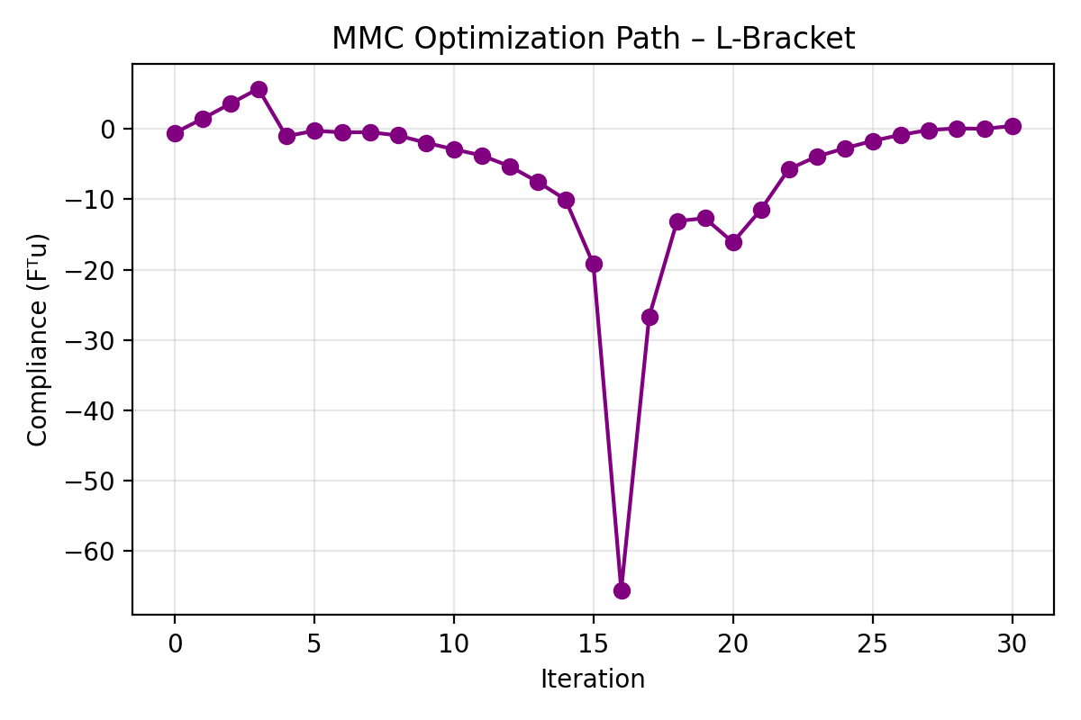
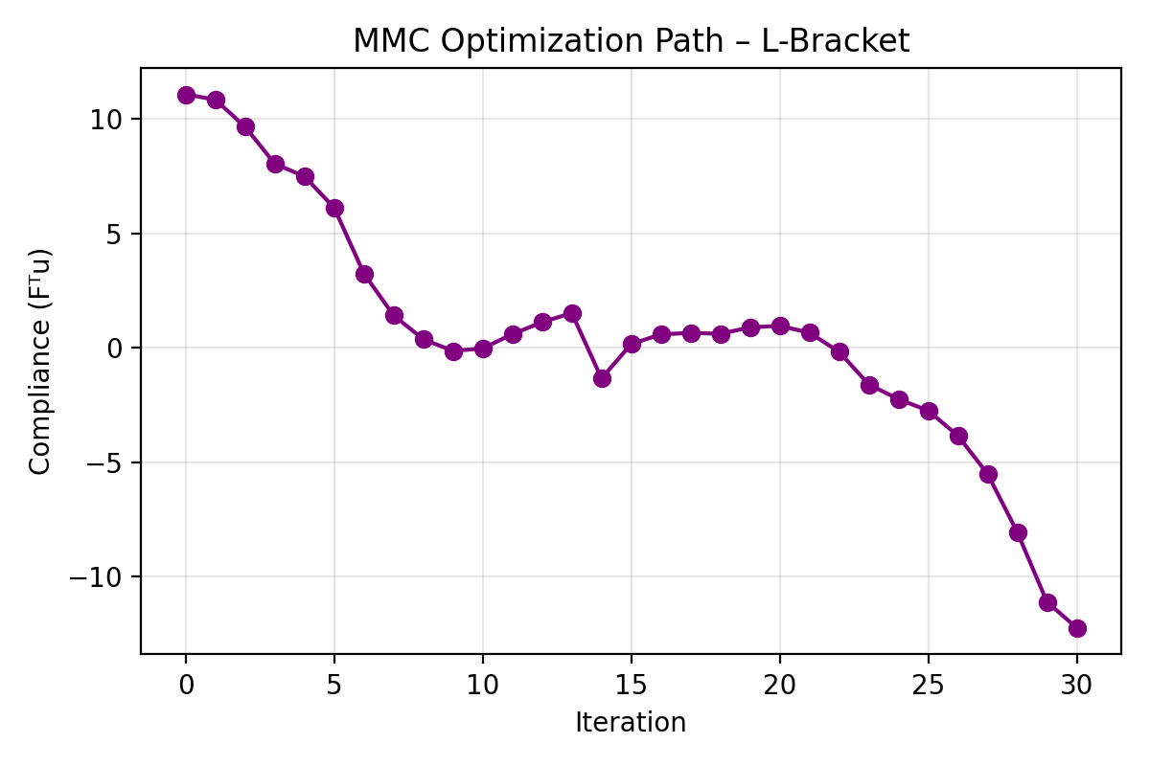
Moving Morphable Components (MMC) Results
Implementation Status
•
Completion: All three geometries operational (L-bracket, Tapered, Ribbed).
Results Summary
Geometry | Load Case | Final Compliance (Norm.)
L-bracket | Horizontal | 0.426 (Baseline)
L-bracket | Vertical | 0.760
Tapered plate | Combined | 11,667.14
Ribbed channel | Upward | -732,240.34
Ribbed channel | Shear | -1,988,492.19
•
Performance: ~30 iterations/run, 118 ms/iteration.
•
Total Time: ~3.5 seconds per optimization.
Note:
Negative values indicate numerical artifacts requiring normalization fix.

Slide 5
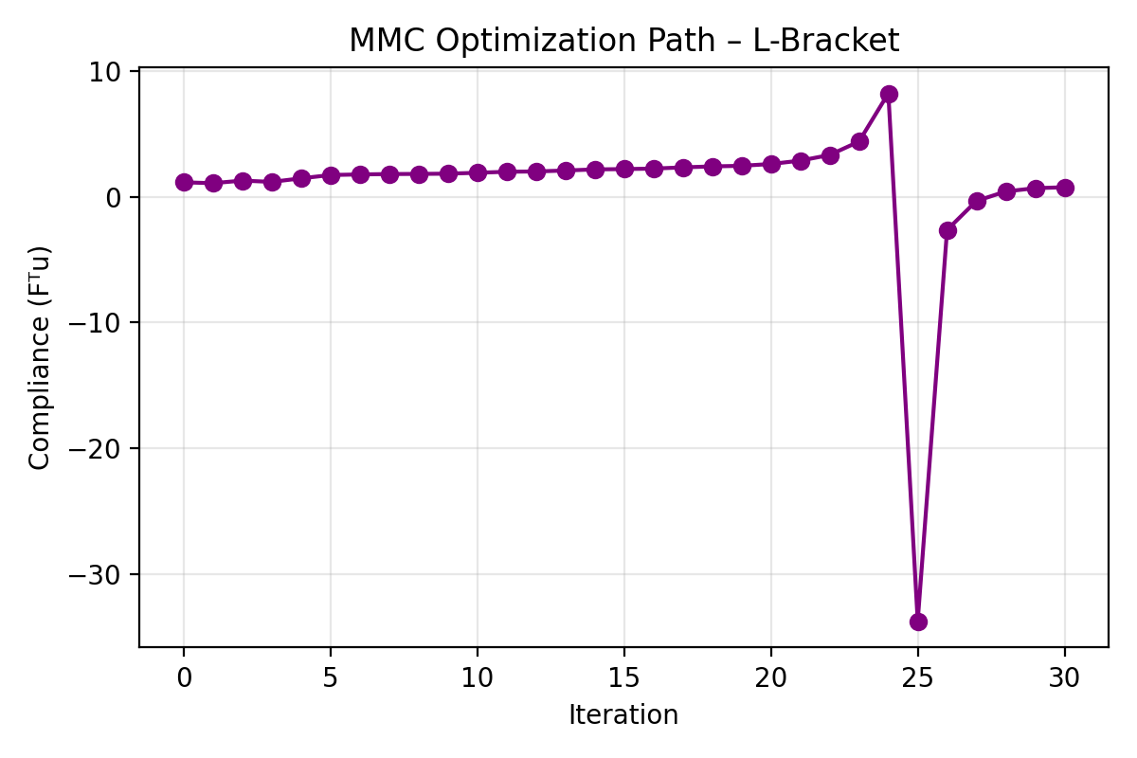
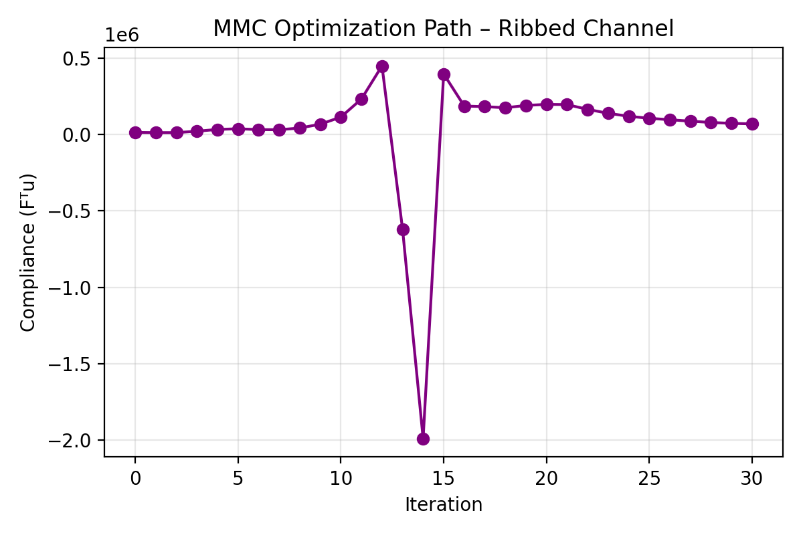
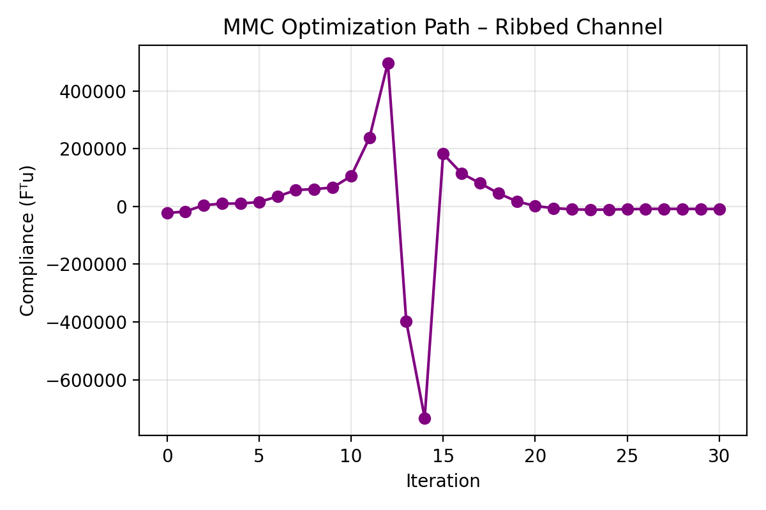
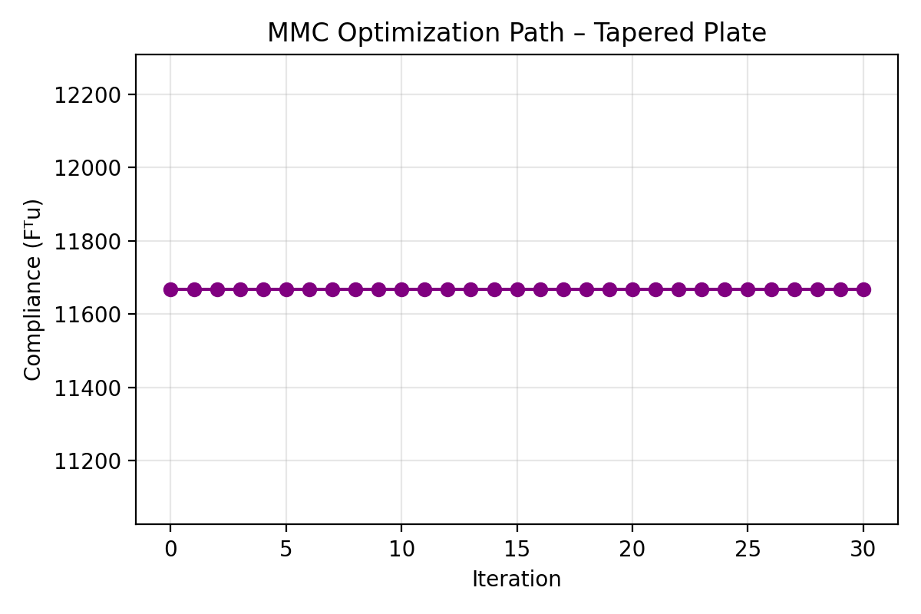
Moving Morphable Components (MMC) Results

Slide 6
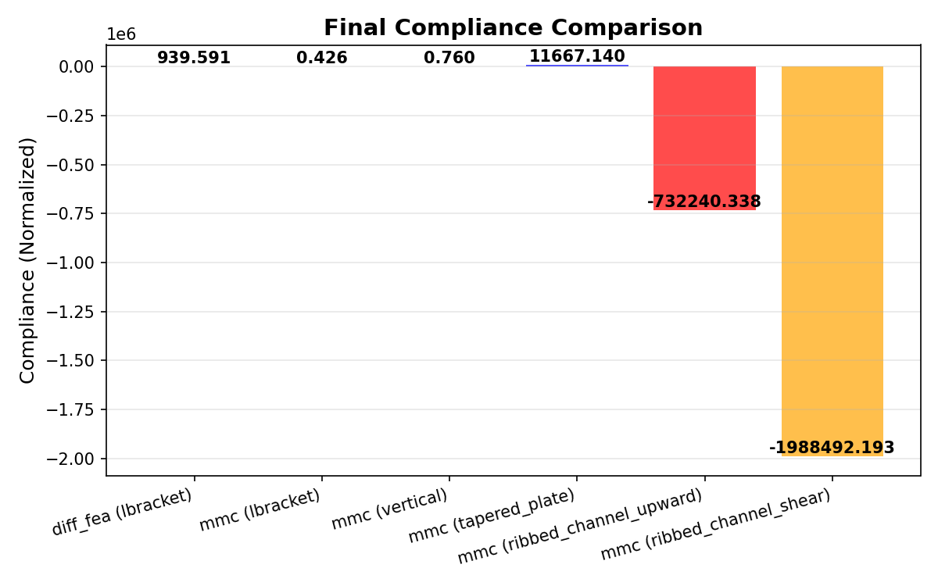
Method Comparison & Trade-Offs
Method | Time/Iter | Training | Generalization
Diff-FEA | 10.4 ms | None | N/A
PINN | 0.009 ms | 2 hrs | Cross-Geometry
MMC | 118 ms | None | Re-optimize
Key Trade-Offs
•
Speed: PINN ≫ Diff-FEA ≫ MMC.
•
Training Cost: PINN requires upfront time; MMC is zero-shot.
•
Flexibility: PINN generalizes; MMC requires new optimization per load.
Comparative Runtimes (Log Scale)

Slide 7





Remaining Work & Next Steps
?
Technical Tasks
Writing Tasks
Decisions Needed
Ansys Validation (<20% error)
- Draft all 8 chapters
•
Freeze scope at 2D/2.5D?
MMC Normalization (to Joules)
- Incorporate supervisor feedback
•
Add 3D PINN-only extension?
Dataset Visualization
- Final formatting and proofreading
•
Proceed with Validation + Writing?

Slide 8
Questions?
Thank you for your guidance.

